Slide 1

Introduction to Xamarin
Chris Cumming Saturday Morning Productions April 18th, 2018
Edmonton Mobile Developers (iOS and Android) Meetup

Slide 2
Prerequisites to Run Demos
Demo Location:
https://github.com/saturdaymp/IntroToXamarinPresentation
Visual Studio 2017
https://www.visualstudio.com/
There is a free community version and VS 2017 Should install most things you need.
To run iOS applications:
Mac (laptop or desktop)
Xcode

Slide 3


Who am I? (i.e. Shameless Self Promotion)
Saturday Morning Productions - Consultant
http://saturdaymp.com
chris.cumming@satudaymp.com
Edmonton .NET Users Group – Program Director
http://edmug.net
info@edmug.net
SQL Saturday #710 – Speaker
http://www.sqlsaturday.com/710/eventhome.aspx

Slide 4

Why Xamarin?
Main reason: Share code between iOS and Android.
Use C#. Don’t have to learn Java, Script, etc.

Slide 5
Quick Demos
Welcome to Xamarin Forms demo.
List demo.

Slide 6
Xamarin Architecture

Slide 7
3 Ways to Share Code
Shared Project
Files compiled in application
Portable Class Library (PCL)
Separate library DLL
Being replaced by .NET Standard Libraries
.NET Standard Library
Replacement for PCL

Slide 8
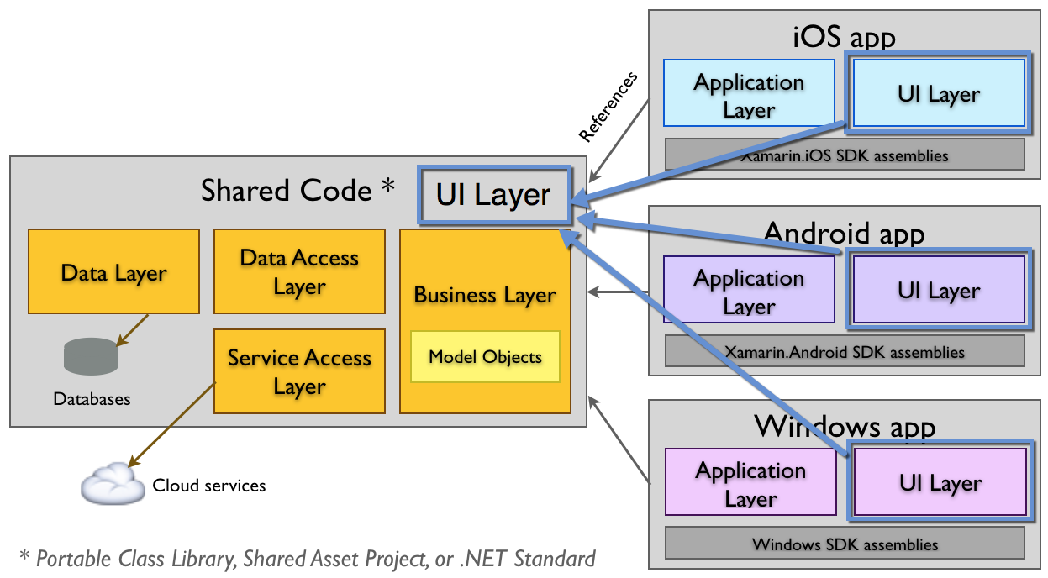
Xamarin Forms Architecture

Slide 9
Platform Specific Code

Slide 10
Text to Speech Demo
https://docs.microsoft.com/en-us/xamarin/xamarin-forms/app-fundamentals/dependency-service/text-to-speech

Slide 11
Start Using
Download Visual Studio 2017 Community (Mac, Windows):
https://www.visualstudio.com/ Need a Mac to compile iOS.
Xamarin Documentation:
https://docs.microsoft.com/en-us/xamarin/
Xamarin University:
https://university.xamarin.com/

